Slide 1
SQL Retrieval Queries
Slide Credit: University of Colorado Boulder
Modified by: Md. Ishan Arefin Hossain, Full-time Lecturer, NSU ECE

Slide 2
SQL Basics
SQL is a relatively simple language
Brief syntax, few commands
SQL is a relatively powerful language
Just a few lines of code can accomplish a LOT of work

Slide 3
Running a Query
SQL Developers refer to a SQL "program" as a "query"
It is not really a "program"

Slide 4
SQL Basics
SQL is NOT really a programming language – it is a QUERY
language
It is NOT PROCEDURAL
That is, it does not execute one statement at a time in sequence, rather, it executes the entire query all at once
All inputs to a SQL query are tables
The output from a query is yet another table called the Answer Set
Some queries may produce interim (temporary) answer sets

Slide 5
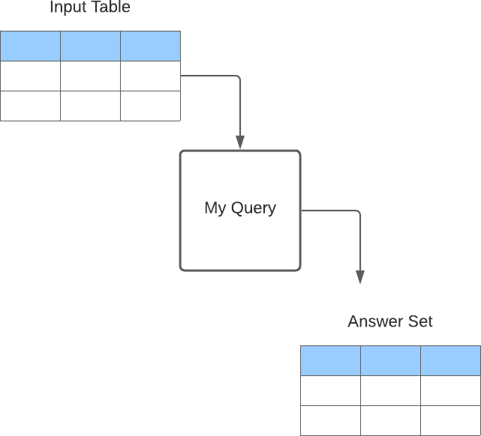
SQL Basics
Simple Query

Slide 6
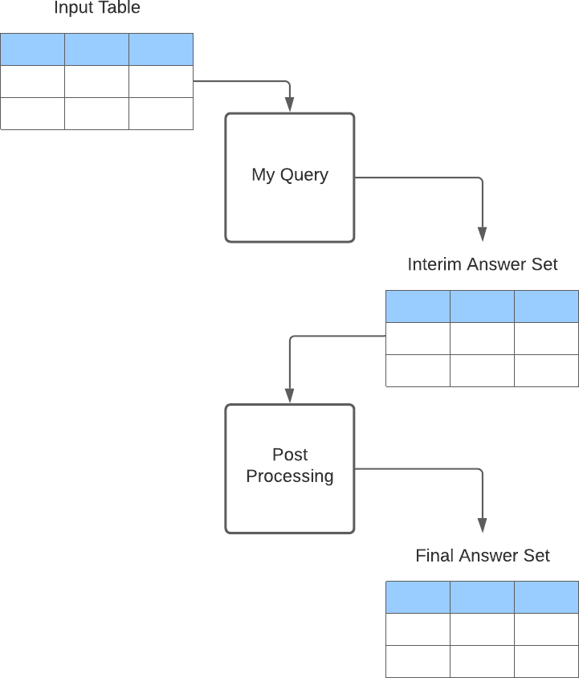
SQL Basics
More Complex Query
Post Processing:
Calculate Subtotals
Sort the Output
Apply Certain Functions

Slide 7
Preparing SQL for Execution
You can't just compile SQL and execute it on your computer like other languages (Java, etc.)
It does not create an executable file (.exe) that you can just run
SQL must be prepared for execution by the DBMS software

Slide 8
Preparing SQL for Execution
When you are ready to run your query, the DBMS must take the following steps:
It parses (syntax checks) the code
It binds the tables & columns
It creates an executable, hands it to the optimizer
The optimizer calculates an execution plan
The DBMS executes the execution plan

Slide 9
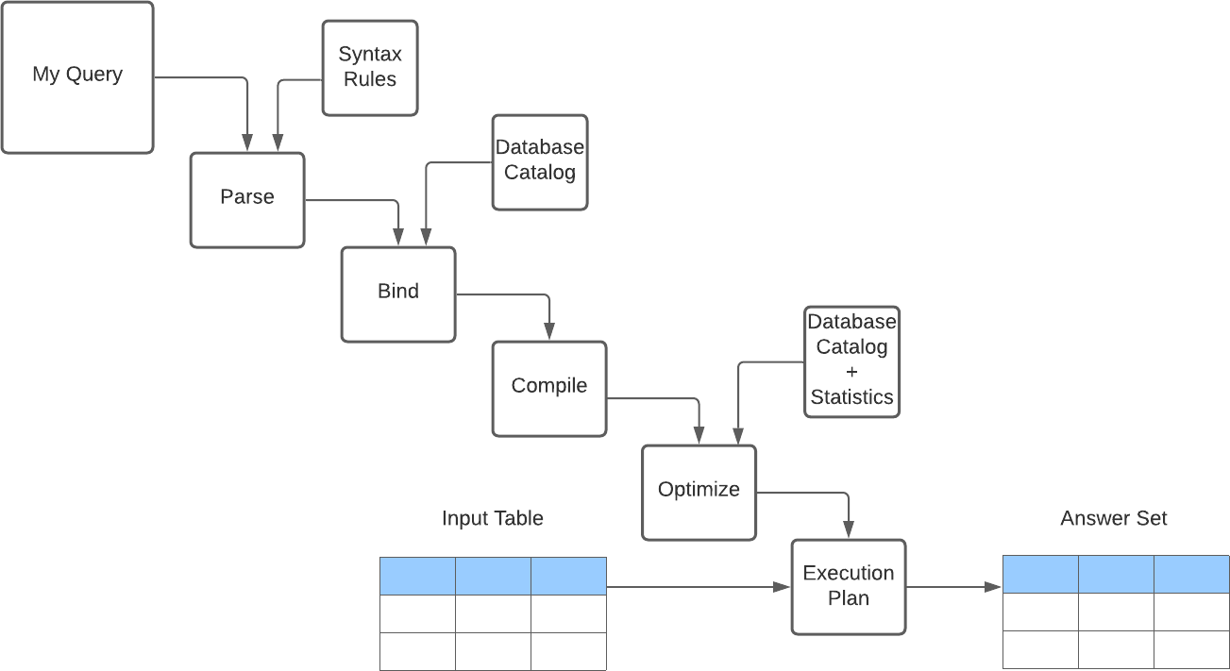
Preparing SQL for Execution

Slide 10
Overview of running a query
Your query must:
Identify which table(s) is input to the query
Define the columns in the answer set
Define any selection criteria
Will this row appear in the answer set?

Slide 11
Overview of running a query
A note on Interim answer sets:
You don't see an interim answer set(s) But it is there, and it consumes resources

Slide 12
Query Tuning
First:
How does the DBMS really work? CPU – Memory – Disk
Relative Speeds:
nanoseconds
microseconds
milliseconds
10

Slide 13
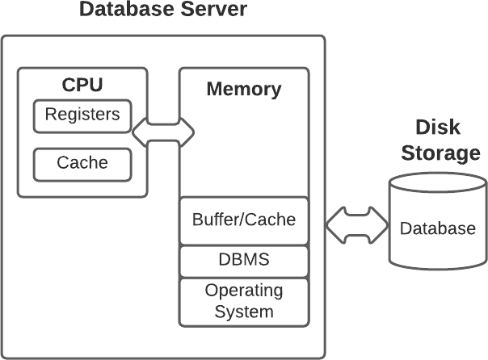
Query Tuning

Slide 14
Query Tuning
Your server can do a million CPU cycles in the time it takes to do ONE Disk I/O

Slide 15
Query Tuning
The optimizer calculates the LEAST COST execution plan.
Goals:
Fastest run time
Minimize use of server resources
Minimize Disk I/O
Use indexes if possible

Slide 16
Query Execution - Summary
When you run a query the DBMS will
Parse your query
Calculate the most efficient Execution Plan
Run your query (all at once, not line by line)
Produce an answer set (perhaps creating interim answer sets along the way...)

Slide 17
The Origins of SQL
Where did SQL come from?
Why do we study SQL?

Slide 18
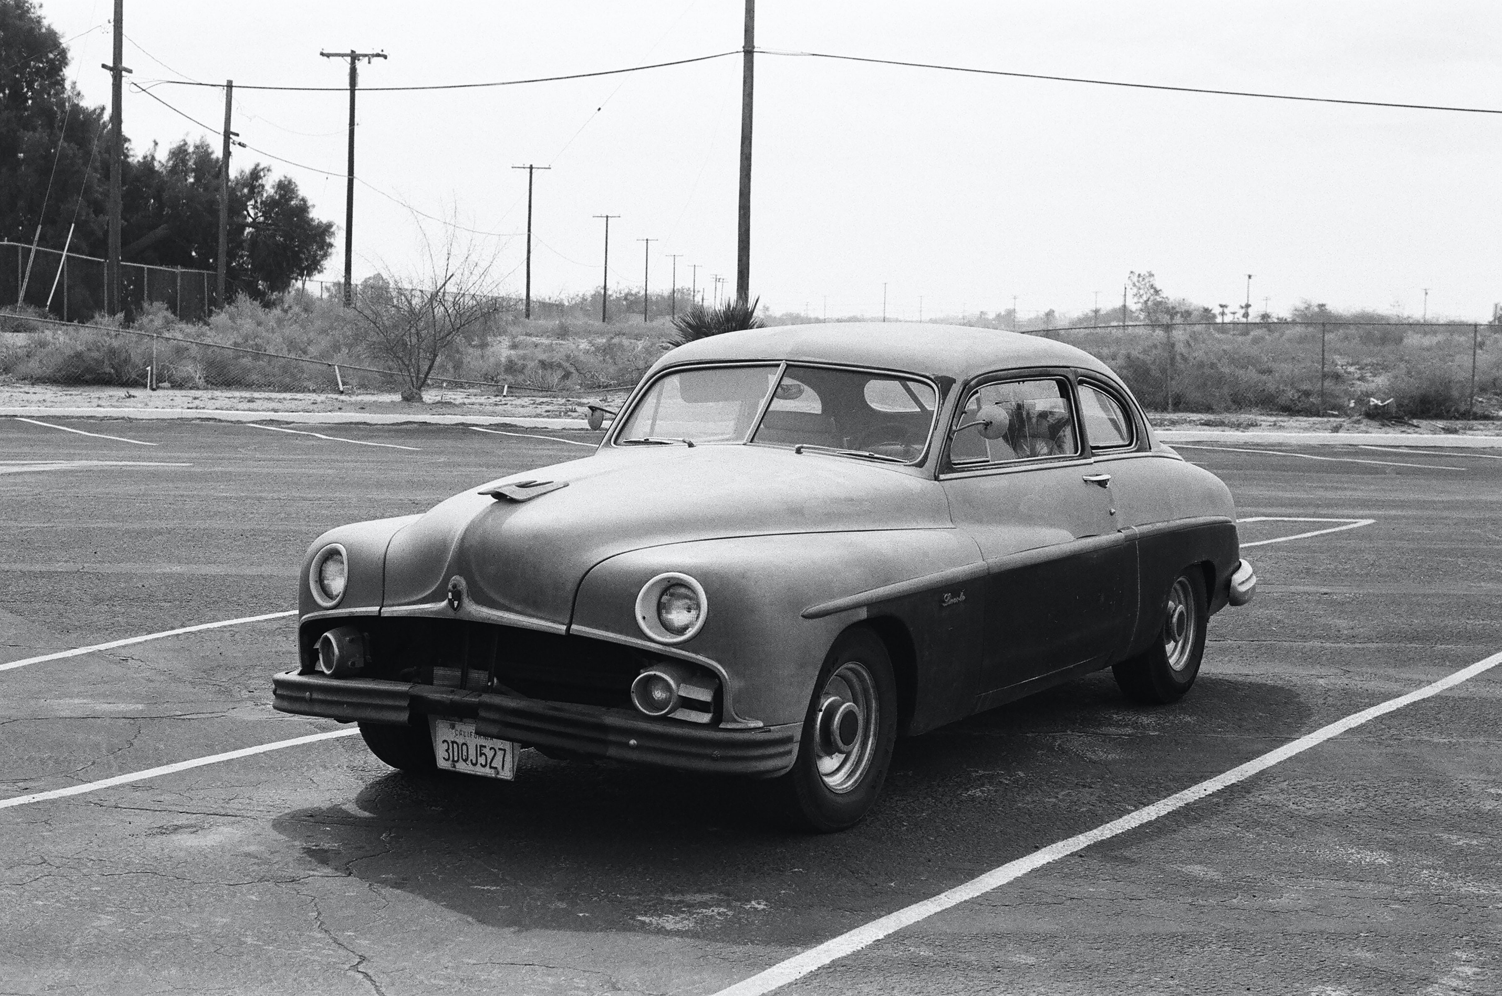
Old Technology?
2
Photo by Randy Laybourne on Unsplash

Slide 19

But Still Widely In Use !
3
Photo by Łukasz Nieścioruk on Unsplash

Slide 20
Old Technology ?
Relational Database Technology
Invented in the 1970's – almost 50 years ago…
Yet about 70% of databases in⁴ use in industry are relational
Industry spent over $30 Billion on relational database software* (2020)
SQL is one of the most in-demand tech skills in the marketplace
* https://www.t4.ai/industry/rdbms-market-share

Slide 21
The Relational Model
Dr. Edgar F. Codd, mathematician, working for IBM published a paper* describing how relational mathematics could be used to store and process business data
Data is stored in TABLES (“relations”)
Tables are related to each other by keys
Data in tables can be stored and retrieved using the structured query language
SQL is based on the branch of mathematics called the relational algebra
* “A relational model for large shared data banks”, 1970, in the ACM journal.

Slide 22
The Relational Model
SQL was initially developed at IBM by Donald D. Chamberlin and Raymond F. Boyce based on Codd's ideas
IBM began developing commercial relational database software products based on Chamberlin and Boyce's work
The System R prototype
System/38 , SQL/DS, and DB2, commercially available in 1979, 1981, and 1983, respectively.
Relational Software, Inc. (now Oracle Corporation) leveraged the potential in the concepts described by Codd, Chamberlin, and Boyce
Developed their own SQL-based RDBMS
June 1979, Relational Software introduced one of the first commercially available implementations of SQL, Oracle V2 (Version2) for VAX computers.

Slide 23
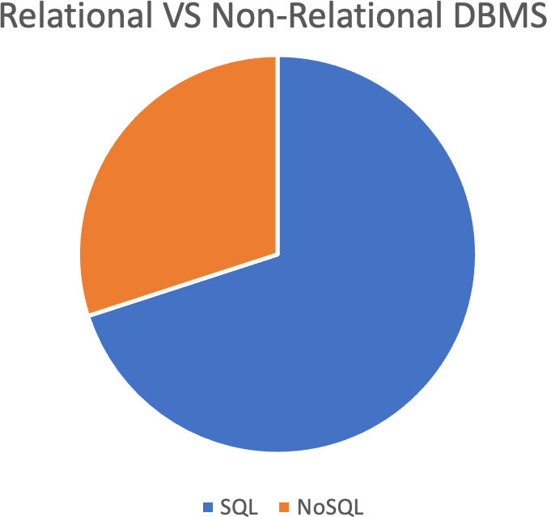
DBMS Software Use
As of 2020, relational DBMS products still hold about 70% marketshare with NoSQL (non-relational) DBMS products comprising about 30%
7

Slide 24
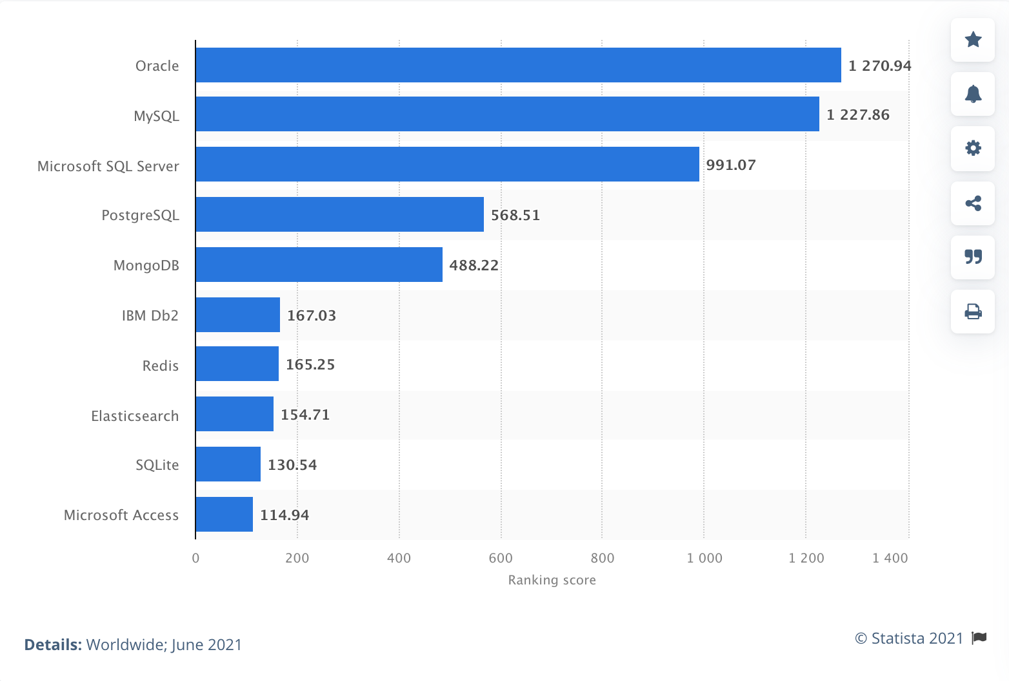
DBMS Software Use (statista.com)
8

Slide 25
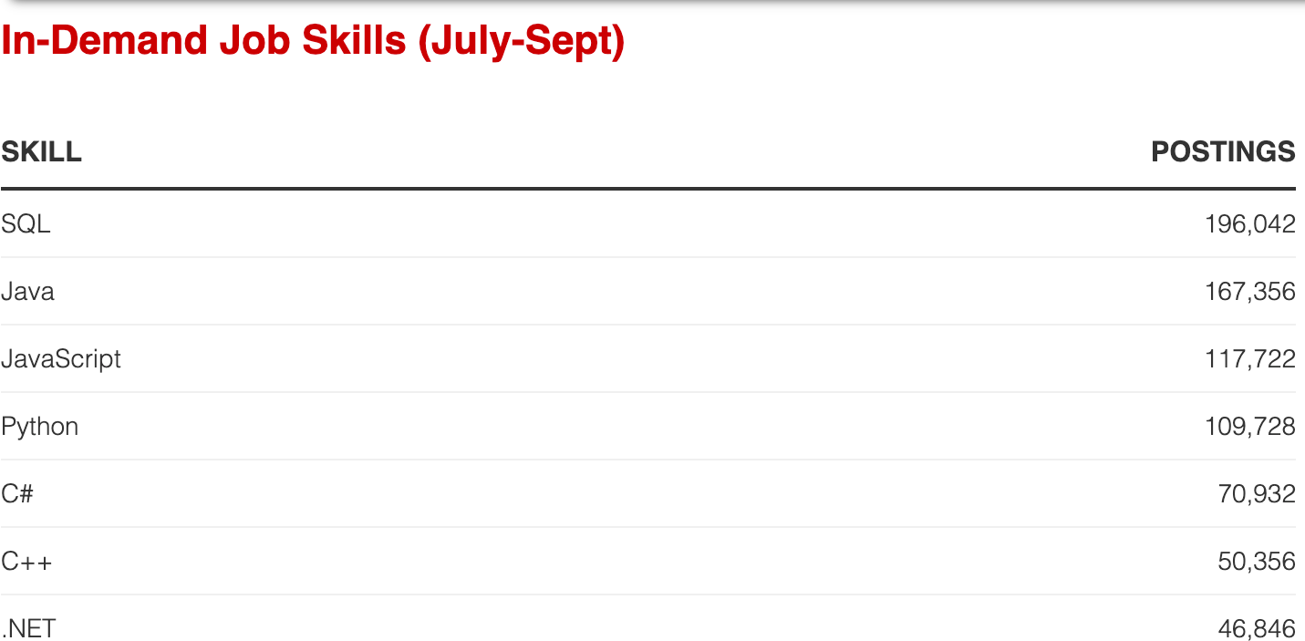
In-Demand Job Skills (dice.com)
9
from dice.com
https://insights.dice.com/2019/10/14/7-programming-languages-employers-want/

Slide 26
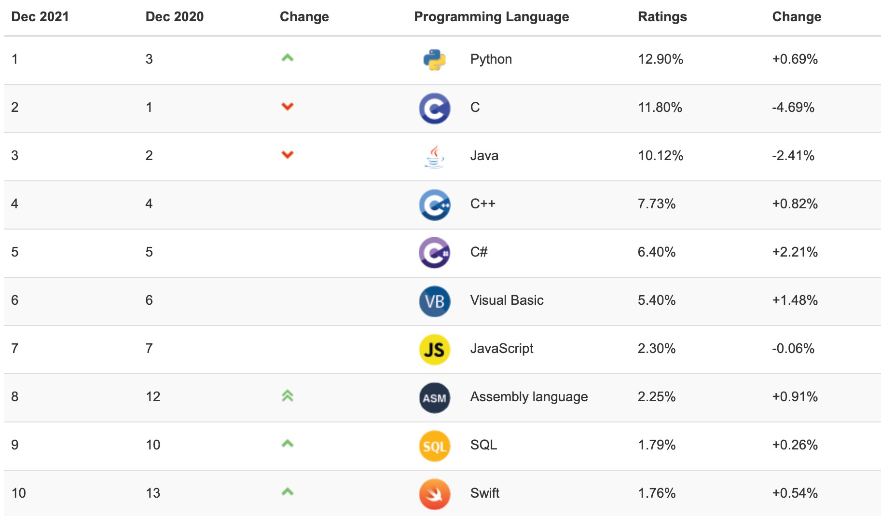
In-Demand Job Skills (TIOBE.com)
10
https://www.tiobe.com/tiobe-index/

Slide 27
In Summary
Relational Databases ("SQL") have been around since the 1970's
Relational Databases still dominate the industry
SQL language progra¹¹mming skills are still in high demand in the marketplace
https://www.tiobe.com/tiobe-index/

Slide 28

SQL Standards
The SQL Language has been around and used heavily for almost 40 years
The SQL Language has gone through some changes over the years
Different software companies customize their implementation of SQL to provide more usability for their database customers
1

Slide 29
SQL Standards
We recently talked about different RDBMS software products, such as
IBM DB2
Oracle
MySQL
Microsoft SQL Server
PostgreSQL

Slide 30
SQL Standards
Each of these vendors maintains their own unique SQL language syntax and command set
They are NOT all the same

Slide 31
SQL Standards
From one DBMS to another, SQL is pretty much the same, but there are some differences
As you learn SQL, it is important for you to understand whose version of SQL you are learning, and how it might different from other versions

Slide 32
SQL Standards
SQL has gone through many standards: starting with SQL-86 or SQL 1.A. SQL-92 is referred to as SQL-2.
Later standards (from SQL-1999) are divided into core specification and specialized extensions. The extensions are implemented for different applications – such as data mining, data warehousing, multimedia etc.
SQL-2006 added XML features (Ch. 13); In 2008 they added Object-oriented features (Ch. 12).
SQL-3 is the current standard which started with SQL-1999. It is not fully implemented in any RDBMS.

Slide 33
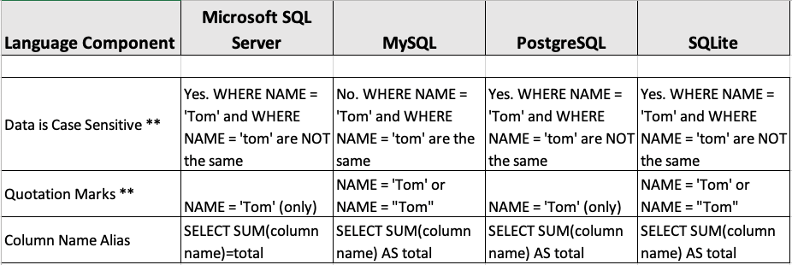
SQL Standards
Examples:
** also depends on the SQL Compiler

Slide 34
SQL Standards
More Examples:
TOP versus LIMIT and ORDER BY
TRIGGERS – before, after, instead of, etc.
ISNULL function
CHECK constraint
Concatenation
Handling DATEs

Slide 35
SQL Standards
Who Cares?
Why should YOU care?
If you write code for one DBMS platform, and then your organization changes your DBMS platform, you will probably have to rewrite and retest your SQL code

Slide 36
SQL Basics
The basic SELECT statement
SELECT <column1>, <column2>, <column3>,
<literal>, <expression>
FROM <table A> ;

Slide 37
SELECT Basics
Commas are required, followed by blanks
Place each clause on a separate line
Indent and vertically align
Semi-colon is required

Slide 38
Pretty Code
Strive for "Pretty" code
Your SQL code may be embedded in a host language
Your queries may be stored in a repository
Your code belongs to your organization
It is good to include comments
Make your code as clear as possible for your reader

Slide 39
SQL Basics
Let's run some examples
select * from "alanparadise/nw"."employees";
(returns all rows and all columns)
select employeeid, lastname, firstname from "alanparadise/nw"."employees";
(returns selected columns)

Slide 40
SQL Basics
Expressions
May be Functions
May be Math

Slide 41
SQL Basics
select lastname, firstname, hiredate, current_date, date_part('month', hiredate)
from "alanparadise/nw"."employees";
select
orderid, unitprice, quantity, unitprice * quantity
from "alanparadise/nw"."orderdetails";

Slide 42
SQL Basics – Column Alias
select orderid, unitprice, quantity,
unitprice * quantity
as "Total Value"
from "alanparadise/nw"."orderdetails";
select lastname, firstname, to_char(hiredate, 'month')
as "Hire Month"
from "alanparadise/nw"."employees";

Slide 43
SQL Basics - Concatenation
Concatenate character columns with
CONCAT(column1, 'literal', column2)
OR
<column> ||
<literal> ||
<column>
<literal>

Slide 44
SQL Basics - Concatenation
select concat(firstname,' ', lastname) as "Name" from employees;
OR
select firstname || ' ' || lastname as "Name" from employees;

Slide 45
SQL Basics - Comments
Comment out a line of code by prefixing it with “- - ”
select concat(firstname,' ', lastname) as "Name"
-- this is concatenating the first and last name
from employees;
"

Slide 46
SQL Basics - Comments
Comment out several lines of code by containing the lines within "/*" and "*/"
select concat(firstname,' ', lastname) as "Name"
/* this is concatenating the first and last name
so that the names are combined */
from employees;

Slide 47
SQL Basics - DATES
DATE - format YYYY-MM-DD
DATETIME - format: YYYY-MM-DD HH:MI:SS
TIMESTAMP - format: YYYY-MM-DD HH:MI:SS
YEAR - format YYYY or YY
DATE - format YYYY-MM-DD
DATETIME - format: YYYY-MM-DD HH:MI:SS
TIMESTAMP - format: YYYY-MM-DD HH:MI:SS
YEAR - format YYYY or YY
MySQL provides several options for storing and querying DATEs
When you create a table with a date, you must specify how you want MySQL to store the date. Options:
DATE - format YYYY-MM-DD
DATETIME - format: YYYY-MM-DD HH:MI:SS
TIMESTAMP - format: YYYY-MM-DD HH:MI:SS
YEAR - format YYYY or YY

Slide 48
SQL Basics - CAST
Converts a column or expression to a different data type Two formats:
CAST (<value> AS <type>)
or
<value>::<type>

Slide 49
SQL Basics – DATES examples
SELECT | Now();
SELECT | Lastname, | Firstname, | Birthdate, | HireDate
FROM "alanparadise/nw"."employees";
SELECT EmployeeID, Lastname, Firstname, age(HireDate, BirthDate) AS HIRE_AGE FROM "alanparadise/nw"."employees";
SELECT EmployeeID, Lastname, Firstname, age(HireDate, BirthDate::text AS HIRE_AGE
FROM "alanparadise/nw"."employees"; SELECT EmployeeID, Lastname, Firstname,
cast (age(HireDate, BirthDate)as text) AS HIRE_AGE FROM "alanparadise/nw"."employees";

Slide 50
SQL Basics – Date Functions
AGE CURRENT_DATE CURRENT_TIME
CURRENT_TIMESTAMP EXTRACT
DATE_PART DATE_TRUNC NOW TO_DATE
TO_TIMESTAMP
Calculates the difference between 2 dates as interval Today's date
Time right now Current Date & Time
Returns a part of a date as interval
Returns part of a date as interval
Returns part of a date truncated to a precision Time right now
Converts a string to a date Converts a string to a timestamp

Slide 51
SQL Basics – DATES examples
SELECT Lastname, Firstname, age (current_date, HireDate)::text FROM "alanparadise/nw"."employees";
SELECT EmployeeID, Lastname, Firstname, extract(year from hiredate) FROM "alanparadise/nw"."employees";
SELECT EmployeeID, Lastname, Firstname, date_part('year', hiredate)
FROM "alanparadise/nw"."employees"; SELECT to_date('20201231', 'YYYYMMDD')

Slide 52
SQL Basics – Nulls
NULL – the cell (column/row) has NO VALUE
NOT blanks, NOT zeros
The presence of a NULL in a cell may affect calculations

Slide 53
SQL Basics – Nulls
NULL – the cell (column/row) has NO VALUE
NOT blanks, NOT zeros
The presence of a NULL in a cell may affect calculations
A cell with NULL will NOT affect an average
A cell with zeros WILL affect an average
Can constrain a column with NOT NULL at creation

Slide 54
SQL Basics – Nulls
select productid, productname, discontinued FROM "alanparadise/nw"."products" where discontinued = '0';
update "alanparadise/nw"."products" set discontinued = NULL where discontinued = '0';
select productid, productname, discontinued from "alanparadise/nw"."products" where discontinued is NULL;
select productid, productname, discontinued from "alanparadise/nw"."products"
where discontinued is NOT NULL;

Slide 55
SQL Basics – Lab # 3
This concludes Module 2, Lesson 4, "Dates & Nulls"
Next step: Follow the instructions for Lab # 3

Slide 56
SQL Basics – The WHERE clause
What if I don't want ALL the rows from the input table to appear in the answer set?
We use the WHERE clause of the SELECT statement to define a CONDITION that determines whether a row from the input table will appear in the answer set.
If the condition is TRUE, the row appears in the answer set

Slide 57
SQL Basics – The WHERE clause
SELECT statement with WHERE clause:
SELECT <column1>, <column2>, <column3>,
<literal>, <expression> AS <alias>
FROM <table>
WHERE <condition> ;

Slide 58
SQL Basics – WHERE Conditions
The condition in the WHERE clause takes this format:
< operand > < operator > < operand >
Operands may be columns, literals or expressions Operator may be
= Equals | != Not equals | <> Not equals
Like | Between | In
> Greater than | >= Greater than or equals
< Less than | <= Less than or equals

Slide 59
SQL Basics - Examples
select customerid, contactname, country from "alanparadise/nw"."customers";
select customerid, contactname, country from "alanparadise/nw"."customers" where country = 'Brazil';
select customerid, contactname, country from "alanparadise/nw"."customers" where Country <> 'Brazil';
select productid, productname, unitprice from "alanparadise/nw"."products" where unitprice > 60;

Slide 60
SQL Basics – LIKE operator
LIKE is used for text/strings only (not numeric columns) LIKE requires use of a WILDCARD character
%
means "zero or more of any character" (underscore) means "exactly one of any character"

Slide 61
SQL Basics - Examples
select customerid, contactname, country from "alanparadise/nw"."customers" where contactname like 'M%'; | select customerid, contactname, country from "alanparadise/nw"."customers" where contactname like '%m%';
select customerid, contactname, country from "alanparadise/nw"."customers" where contactname like '%M%'; | select customerid, contactname, country from "alanparadise/nw"."customers" where contactname like '_a%';

Slide 62
SQL Basics – IN operator
The IN operator compares an operand to a list of values
WHERE <operand> in (<value>, <value>, <value>)
The <value> may be a literal or a column
The <value> must match the data type of the operand

Slide 63
SQL Basics - Examples
select productid, productname, unitprice, supplierid from "alanparadise/nw"."products"
where supplierid in (2, 4, 6, 8);
select supplierid, companyname, region from "alanparadise/nw"."suppliers" where region in ('LA', 'MI', 'OR');

Slide 64
SQL Basics – IN operator
WHERE <operand> in (<value1>, <value2>, <value3>)
This is the equivalent of
WHERE | <operand> | = | <value1> | OR
 | <operand> | = | <value2> | OR
 | <operand> | = | <value3>

Slide 65
“some” Clause
Find names of instructors with salary greater than that of some (at least one) instructor in the Biology department.
Same query using > some clause
select distinct T.name
from instructor as T, instructor as S
where T.salary > S.salary and S.dept name = 'Biology';
select name
from instructor
where salary > some (select salary
from instructor
where dept name = 'Biology');

Slide 66
Definition of “some” Clause
F <comp> some r ⇔ ∃ t ∈ r such that (F <comp> t ) Where <comp> can be: <, ≤, >, =, ≠
0
(5 < some
5
) = true
(read: 5 < some tuple in the relation)
6
0
(5 < some
5
) = false
0
(5 = some
) = true
5
0
(5 ≠ some
5
) = true (since 0 ≠ 5)
(= some) ≡ in
However, (≠ some) ≡ not in

Slide 67
“all” Clause
Find the names of all instructors whose salary is greater than the salary of all instructors in the Biology department.
select name
from instructor
where salary > all (select salary
from instructor
where dept name = 'Biology');

Slide 68
Definition of “all” Clause
F <comp> all r ⇔ ∀ t ∈ r (F <comp> t)
0
(5 < all
5
) = false
6
6
(5 < all
) = true
10
4
(5 = all
) = false
5
4
(5 ≠ all
) = true (since 5 ≠ 4 and 5 ≠ 6)
6
(≠ all) ≡ not in
However, (= all) ≡ in

Slide 69
SQL Basics – BETWEEN operator
WHERE <operand> between <value1> and <value2>
The between is inclusive
The <value> must match the data type of the operand

Slide 70
SQL Basics – BETWEEN operator
WHERE <operand> between <value1> and <value2>
This is the equivalent of
WHERE | <operand> | >= | <value1> | AND
 | <operand> | <= | <value2>

Slide 71
SQL Basics
Examples
select ProductID, ProductName, UnitPrice from "alanparadise/nw"."products" where UnitPrice between 20 and 30;
select Lastname, Firstname
from "alanparadise/nw"."employees" where Lastname between 'A' and 'M';

Slide 72
SQL Basics – Boolean
Multiple conditions in a WHERE clause can be combined with
"AND", "OR"
Any condition in a WHERE clause can be negated with "NOT"

Slide 73
SQL Basics: Boolean
Boolean expressions are not English ! negates the whole condition
NOT
SELECT customerid, contactname, region, country from "alanparadise/nw"."customers"
where
country = 'Brazil';
SELECT Customerid, contactname, region, country from "alanparadise/nw"."customers"
where
country NOT = 'Brazil';
SELECT customerid, contactname, region, country from "alanparadise/nw"."customers"
where
NOT country = 'Brazil';

Slide 74
SQL Basics
When combining WHERE conditions using Boolean operators, please make a habit of using parentheses
SELECT Productname, SupplierID, CategoryID,
UnitPrice, UnitsInStock
from "alanparadise/nw"."products"
WHERE SupplierID = 1 AND CategoryID = 2 OR CategoryID = 3 AND UnitPrice > 20 OR UnitsInStock < 12;
SELECT Productname, SupplierID, CategoryID,
UnitPrice, UnitsInStock
from "alanparadise/nw"."products"
WHERE SupplierID = 1 AND (CategoryID = 2 OR CategoryID = 3 AND UnitPrice > 20) OR
UnitsInStock < 12;

Slide 75
SQL Basics - DISTINCT
Your SQL answer set may contain duplicate values in a column
The “distinct” keyword before a column in the SELECT removes duplicates from the answer set
Example Analysis:
87 Customers, each one has a country
How many distinct countries are they from?

Slide 76
SQL Basics – COUNT()
The count( ) function counts rows OR non-null values within a column in the answer set.
Example:
select count(*)
from "alanparadise/nw"."customers";
select count(country)
from "alanparadise/nw"."customers";
select count(distinct country)
from "alanparadise/nw"."customers";

Slide 77
SQL Basics – ORDER BY
You can sort the rows in your answer set with ORDER BY
Default: ASC Option: DESC
select productname, unitprice
from "alanparadise/nw"."products" order by productname;
select productname, unitprice
from "alanparadise/nw"."products" order by unitprice desc;
select productname, unitprice
from "alanparadise/nw"."products" order by 2 desc;

Slide 78
SQL Basics – LIMIT
The LIMIT clause tells SQL to return only XX rows in the answer set.
select productname, unitprice
from "alanparadise/nw"."products" order by unitprice desc limit 5;
This replaces the "TOP" clause available in MS SQL Server and the "FETCH" clause available in Oracle.

Slide 79
SQL Group Functions
Query
GROUP
Function

Slide 80
SQL Group Functions
The Group Function
SQL creates an interim answer set
SQL processes the group function against the interim answer set
Final answer set contains only the final result for the function

Slide 81
SQL Group Functions
Note on GROUP FUNCTION with a WHERE clause:
The WHERE clause determines the number of rows in the INTERIM answer set
The GROUP function does its calculation against the rows in the INTERIM answer set AFTER the WHERE is done

Slide 82
SQL Group Functions/ Aggregate Functions
SUM Sums the non-null values in a column
AVG Calculates the average of the non-null values in a column COUNT Counts how ma⁶ ny rows have a non-null value in a column MIN Returns the lowest non-null value in a column
MAX Returns the highest non-null value in a column

Slide 83
SQL Group Functions
NOTE:
SUM, AVG can only be used with NUMERIC columns
MIN, MAX can be used with any data type column
COUNT can be used with any data type column, or with a (*) to simply count rows

Slide 84
SQL Group Functions
select COUNT(*) as "Staff Size"
from "alanparadise/nw"."employees"; select COUNT(Distinct Country) as "Countries"
from "alanparadise/nw"."customers"; select SUM(unitsinstock) as "Inventory"
from "alanparadise/nw"."products"; select MAX(unitprice) as "High Price" from "alanparadise/nw"."products";
select MIN(unitPrice) as "Low Price" from "alanparadise/nw"."products";

Slide 85
SQL Group Functions
select AVG(unitprice) as "Average Price" from "alanparadise/nw"."products";
select to_char(avg(UnitPrice),'999,999.99') as "Average Price" from "alanparadise/nw"."products";
NOTE: It rounded the result...

Slide 86
SQL Group Functions
Count Example –
select COUNT(*) as "Staff Size"
from "alanparadise/nw"."employees";
select COUNT(employeeid) as "Staff Size" from "alanparadise/nw"."employees";
Are these the same? How are they different?

Slide 87
SQL Group Functions
RULE:
The level of the group function must match the level of detail in your select statement.
Look at the example on the next slide

Slide 88
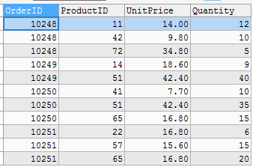
SQL Group Functions
SELECT OrderID, ProductID, UnitPrice, Quantity FROM "alanparadise/nw"."orderdetails"
WHERE OrderID in (10248, 10249, 10250, 10251);
12

Slide 89

SQL Group Functions
SELECT OrderID, ProductID, SUM(UnitPrice), SUM(Quantity)
FROM "alanparadise/nw"."orderdetails"
WHERE OrderID in (10248, 10249, 10250, 10251);
Which PRODUCT(s)??
Which ORDER(s)??
Totals

Slide 90
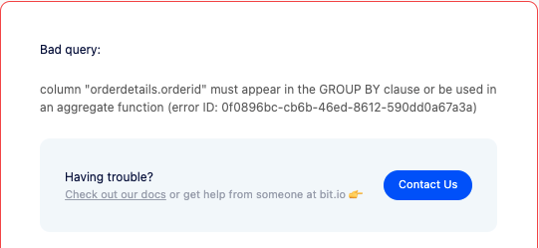
SQL Group Functions
This level mis-match generates an error
14

Slide 91
SQL Group Functions
To comply with this rule, and to avoid this error, we must consider the next topic: GROUP BY

Slide 92
SQL Group By
We have seen that Group Functions summarize values in an interim answer set to return values grouped across many rows.
The GROUP BY clause enables SQL to provide subtotals.
The GROUP BY tells SQL to perform the group function across a subset of rows in the interim answer set and provide a total for each subset of rows.

Slide 93
SQL Group By
Remember that this query triggers an error?
SELECT OrderID, ProductID, SUM(UnitPrice), SUM(Quantity) FROM "alanparadise/nw"."orderdetails"
WHERE OrderID in (10248, 10249, 10250, 10251);
➔ Single sums; many orders & products.
The level of the group function must match the level of detail in your select statement.

Slide 94
SQL Group By
By adding a GROUP BY, we avoid the mismatch, and get subtotals by OrderID.
SELECT OrderID, SUM(UnitPrice) as "Total Price", SUM(Quantity) as "Total Quantity"
FROM "alanparadise/nw"."orderdetails"
WHERE OrderID in (10248, 10249, 10250, 10251) GROUP BY OrderID;

Slide 95
SQL Group By
To avoid this mismatch, remember the rule:
When using a GROUP BY, every column/expression in the SELECT statement must either be
a group function
OR
a column that you are grouping by

Slide 96
SQL Group By
Let's practice
How many customers does Northwinds have in each country?
SELECT country, count(customerid) as "Total" FROM "alanparadise/nw"."customers"
GROUP BY country;
What is the average product price for each supplier?
SELECT supplierid, avg(unitprice) as "Total" FROM "alanparadise/nw"."products"
GROUP BY supplierid;
(How can I make this output more useful?)

Slide 97
SQL Group By
NOTE:
Even though the GROUP FUNCTION is sorting the interim answer set in order to calculate totals, you must STILL use an ORDER BY to list the totals in group sequence.

Slide 98
SQL Group By
3. From which supplier does Northwinds carry the most inventory?
SELECT SupplierID, SUM(UnitsInStock)AS "Inventory" FROM "alanparadise/nw"."products"
GROUP BY SupplierID ORDER BY 2 DESC LIMIT 1;

Slide 99
SQL Group By
HAVING
Defines a condition that selects a subset of rows from the answer set based on the group functions
8
When you use a GROUP BY, the HAVING is like a WHERE clause against the interim answer set
The syntax rules for condition in the HAVING are the same as for the WHERE

Slide 100
SQL Group By
4. In which countries does Northwinds have more than five customers?
SELECT country, count(customerid) as "Total"
9
FROM "alanparadise/nw"."customers" GROUP BY country
HAVING count(customerid) > 5 ORDER BY 2 DESC;

Slide 101
SQL Group By
Remember:
You can select rows using the WHERE You can select rows usin¹g⁰ the HAVING
So what's the difference?

Slide 102
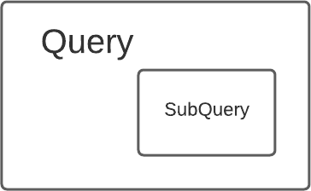
SQL SubQueries
The SubQuery Simply Defined:
A query within a query

Slide 103
SQL SubQueries
SubQuery – Three modes of use
Subquery in WHERE.
The answer set to the “inner” query is used as a predicate in a where clause in the “outer” query.
Subquery in SELECT.
The answer set to the “inner” query is used as a column in a select
Subquery in FROM.
The answer set to the “inner” query is used as a "virtual" table in a from clause.
Subquery must always be enclosed in parentheses!

Slide 104
SQL SubQueries
Example 1 – Predicate in a WHERE clause with = operator
Find the productID, name and unit price of the highest priced product Northwinds sells.
select productID, productname, unitprice from "alanparadise/nw"."products" where UnitPrice = (
select MAX(UnitPrice)
from "alanparadise/nw"."products" )
Note that with the “equals” condition, the inner query returns only one value (one row, one column)

Slide 105
SQL SubQueries
Example 2 – Predicate in a WHERE clause with "in" operator
Find the CustomerID and the OrderID for all orders with more than 100 units sold.
select customerID, orderID
from "alanparadise/nw"."orders" where orderID in (
select orderID
from "alanparadise/nw"."orderdetails" where quantity > 100 )
Order by CustomerID
Note that with the “in” condition, the inner query returns many values (many rows, one column) as a list
NOTE also: this is hitting TWO different tables

Slide 106
SQL SubQueries
Example 3 – Expression in a SELECT clause
List each product name and the total value of that product's orders
select productname, (select sum(UnitPrice * quantity)
from "alanparadise/nw"."orderdetails"
where "alanparadise/nw"."orderdetails".productid = "alanparadise/nw"."products".productid) as "Total"
from "alanparadise/nw"."products"
Note that the inner query returns only one value (one row, one column)

Slide 107
SQL SubQueries
Example 4 – Subquery in FROM.
Create a list of all orders with fewer than 100 items sold.
SELECT orderID
FROM (SELECT orderID, SUM(quantity)
from "alanparadise/nw"."orderdetails" GROUP BY OrderID
HAVING SUM(quantity) < 100) AS DetailCount;
NOTE: the subquery must have an alias name

Slide 108
SQL SubQueries
Co-Related SubQuery
Special type of subquery
The inner query references a value from the outer qeury
The inner query is executed each time the outer query returns another row.
NOTE: Can yield performance issues.

Slide 109
SQL SubQueries
Example 5 – Correlated Sub-Query
Select all the employees where the employee had orders shipped to customers in
the employee's own home city.
SELECT O.employeeID, orderID, shipcity, customerID FROM "alanparadise/nw"."orders" O
WHERE employeeID IN
(SELECT employeeID FROM "alanparadise/nw"."employees" E WHERE E.City = O.shipcity);

Slide 110
SQL SubQueries
NOTE: This example uses a temporary alias for the table name.
FROM "alanparadise/nw"."employees" E
This serves two purposes:
The employeeid is ambiguous, since it appears in both the orders table and the employees table.
The alias saves typing and makes the query code more clear and readable

Slide 111
The EXISTS and UNIQUE Functions in SQL for correlating queries
EXISTS function
Check whether the result of a correlated nested query is empty or not. They are Boolean functions that return a TRUE or FALSE result.
EXISTS and NOT EXISTS
Typically used in conjunction with a correlated nested query
SQL function UNIQUE(Q)
Returns TRUE if there are no duplicate tuples in the result of query Q

Slide 112
USE of EXISTS
Q7:
SELECT Fname, Lname
FROM Employee
WHERE EXISTS (SELECT *
FROM DEPENDENT
WHERE Ssn= Essn)
AND EXISTS (SELECT *
FROM Department
WHERE Ssn= Mgr_Ssn)

Slide 113
USE OF NOT EXISTS
To achieve the “for all” (universal quantifier- see Ch.8) effect, we use double negation this way in SQL:
Query: List first and last name of employees who work on ALL projects controlled by Dno=5.
SELECT Fname, Lname
FROM Employee
WHERE NOT EXISTS ( (SELECT Pnumber
FROM PROJECT
WHERE Dno=5)
EXCEPT (SELECT Pno
FROM WORKS_ON
WHERE Ssn= ESsn)
The above is equivalent to double negation: List names of those employees for whom there does NOT exist a project managed by department no. 5 that they do NOT work on.

Slide 114
Double Negation to accomplish “for all” in SQL
Q3B: SELECT Lname, Fname
FROM EMPLOYEE
WHERE NOT EXISTS ( SELECT *
FROM WORKS_ON B
WHERE ( B.Pno IN ( SELECT Pnumber
FROM PROJECT
WHERE Dnum=5 AND
NOT EXISTS (SELECT *
FROM WORKS_ON C
WHERE C.Essn=Ssn
AND C.Pno=B.Pno )));
The above is a direct rendering of: List names of those employees for whom there does NOT exist a project managed by department no. 5 that they do NOT work on.

Slide 115
SQL Joins
In order to run a query that retrieves data from multiple tables, we must JOIN those tables
Joining two tables requires that the two tables have a
common key (typically a foreign key relationship) that appears in both tables
The common key columns need NOT have the same name, but must be of the same data type and length.
A JOIN is one of the more resource intensive activities one can do in a relational database.

Slide 116
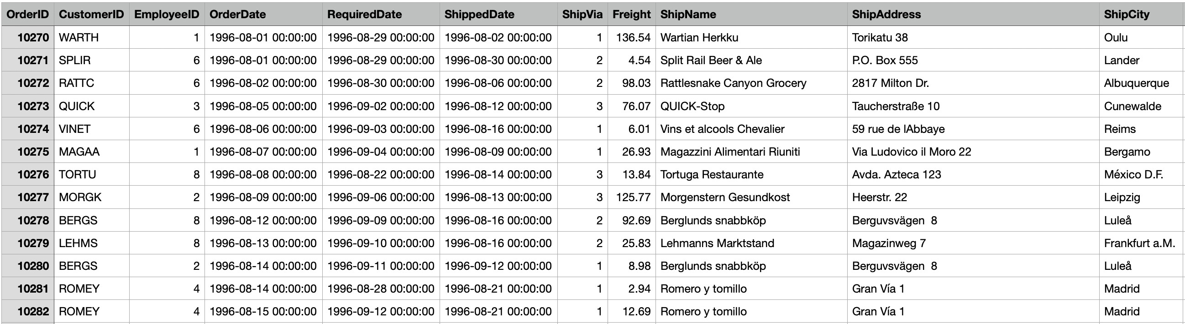
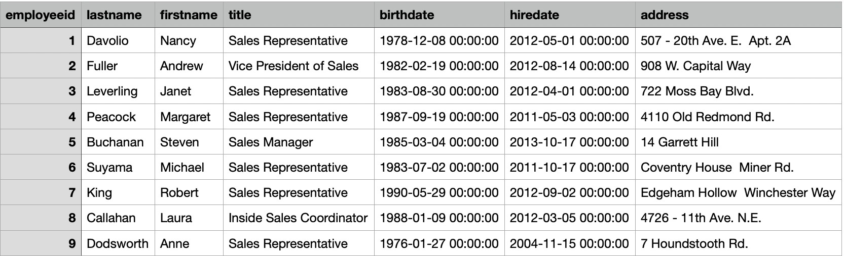
SQL Joins
Basic Example: joining Orders to Employees
Orders
Employees
2

Slide 117
SQL Joins
Basic Example: joining Orders to Employees
Orders
Employees
3

Slide 118
SQL Joins - Basic Example
Let’s join Orders to Employees
Orders has 830 rows, each with an EmployeeID
Employees has 9 rows, each with an EmployeeID
They have a common key: EmployeeID
(primary key in Employees; foreign key in Orders)
We want SQL to join the rows in Employees and Orders where the EmployeeID matches
This is called an "Inner Join" or "Equijoin"

Slide 119
SQL Joins - Basic Example
Provide a listing showing Northwinds employees and a count of each employee’s orders sorted from highest to lowest
SELECT LastName, Firstname, count(OrderID) as "Order Total" from "alanparadise/nw"."employees",
"alanparadise/nw"."orders"
where "alanparadise/nw"."employees"."employeeid" = "alanparadise/nw"."orders"."employeeid"
GROUP BY LastName, FirstName Order By 3 desc;

Slide 120
SQL Joins - Basic Example
Add the EmployeeID to the answer set:
SELECT LastName, Firstname, count(OrderID) as "Order Total"
employeeid,
from "alanparadise/nw"."employees", "alanparadise/nw"."orders"
where "alanparadise/nw"."employees"."employeeid" = "alanparadise/nw"."orders"."employeeid"
GROUP BY LastName, FirstName Order By 3 desc;
What happens?

Slide 121
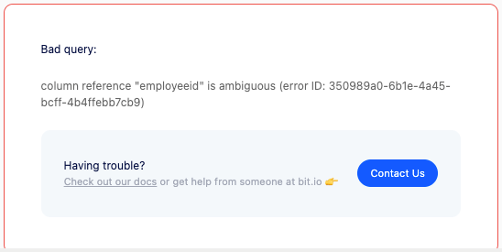
SQL Joins - Basic Example
7

Slide 122
SQL Joins – Qualifying Column Names
“EmployeeID” exists in BOTH tables in this query.
We need to tell SQL which table to get it from.
We prefix the table name in front of the column name separated by a “ . ”
Failure to fully qualify the column name will result in an “ambiguous column” error
(We must also add it to the Group By...)

Slide 123
SQL Joins - Qualifying Column Names
Add EmployeeID to the answer set:
SELECT "alanparadise/nw"."employees".employeeid, LastName, Firstname, count(OrderID) as "Order Total"
from "alanparadise/nw"."employees", "alanparadise/nw"."orders"
where "alanparadise/nw"."employees"."employeeid" = "alanparadise/nw"."orders"."employeeid"
GROUP BY "alanparadise/nw"."employees".employeeid, LastName, FirstName Order By 3 desc;

Slide 124
SQL Joins – Table Alias
To save typing, we can define an “alias” for each table.
We can temporarily – only for the duration of this query -- rename the employees table “E”, and rename the orders table “O”.
SELECT LastName, Firstname, count(OrderID) as "Order Total" from "alanparadise/nw"."employees" E,
"alanparadise/nw"."orders" O where E.employeeid = O.employeeid
GROUP BY LastName, FirstName Order By 3 desc;

Slide 125
SQL Implicit and Explicit
SQL has two types of inner joins: Implicit and Explicit
Implicit inner join:
SELECT LastName, Firstname, count(OrderID) as "Order Total" from "alanparadise/nw"."employees" E,
"alanparadise/nw"."orders" O
where E.employeeid = O.employeeid
GROUP BY LastName, FirstName Order By 3 desc;

Slide 126
SQL Joins – Alternate Syntax
Explicit Join
Uses the JOIN ... ON clause.

Slide 127
SQL Implicit and Explicit
SQL has two types of inner joins: Implicit and Explicit
Explicit inner join
SELECT LastName, Firstname, count(OrderID) as "Order Total"
FROM "alanparadise/nw"."employees" E "alanparadise/nw"."orders" O
JOIN
on E.employeeid = O.employeeid
GROUP BY LastName, FirstName Order By 3 desc;

Slide 128
SQL Joins – Alternate Syntax
Explicit or Implicit,
The choice is YOURS !
BUT – not with the OUTER JOIN...

Slide 129
SQL Joins – Three Way
Suppose you are asked to create a report showing the top five employees in sales dollar volume.
Let's start with understanding the data.
First, consider which tables are needed.
Then determine the join key.

Slide 130
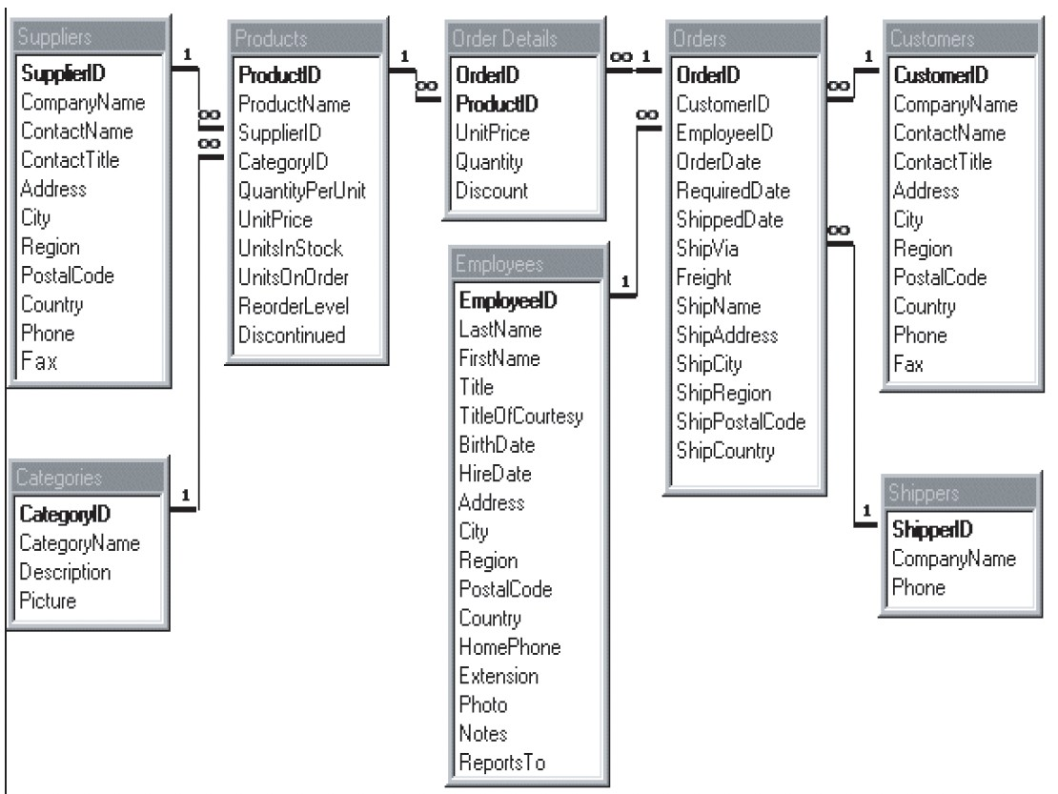
SQL Joins – Thre
Join Employees to Orders on EmployeeID.
Join Orders to Order Details on OrderID.
Sales volume = UnitPrice * Quantity

Slide 131
SQL Joins – Three Way
SELECT LastName, Firstname, sum(unitprice * quantity) as "Total Sales" from "alanparadise/nw"."employees" E
JOIN
"alanparadise/nw"."orders" O ON E.employeeid = O.employeeid JOIN
"alanparadise/nw"."orderdetails" D ON O.orderid GROUP BY LastName, FirstName
Order By 3 desc LIMIT 5;
= D.orderid

Slide 132
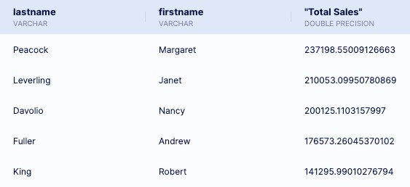
SQL Joins – Three Way

Slide 133

SQL Joins – Cartesian Product
Beware the Cartesian Product !!
Product = one table multiplied by another table
René DesCartes
The JOIN often creates a product, then selects rows from the product where the keys match

Slide 134


SQL Joins – Cartesian Product
Beware the Cartesian Product !!
I think...
Therefore I am !!
Product = one table multiplied by another table
René DesCartes
The JOIN often creates a product, then selects rows from the product where the keys match

Slide 135
SQL Joins – Cartesian Product
For example, let’s join Orders to Employees
Orders has 14 columns, 830 rows
Employees has 17 columns, 9 rows
The Cartesian product has 31 (14+17) columns, and 7470 (830 * 9) rows – most of which are meaningless

Slide 136
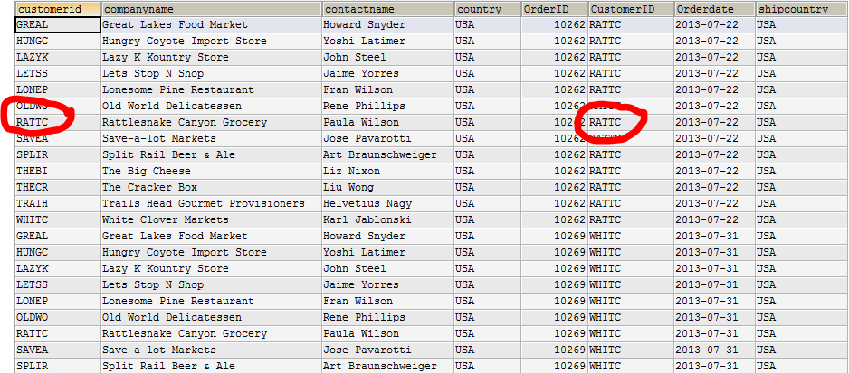
SQL Joins - Cartesian Product
Cartesian Product from an unqualified join:
4

Slide 137
SQL Joins - Cartesian Product
Cartesian Product
SQL will go through the Cartesian Product (which is an INTERIM answer set) row-by-row, and select only those rows where the EmployeeID from Employees is equal to the EmployeeID from Orders
Therefore, we must include the JOIN or WHERE clause that describes this condition
Failure to fully qualify a JOIN operation with a JOIN/WHERE clause that matches all necessary keys will cause your answer set to include a Cartesian Product (which is mostly meaningless)

Slide 138
SQL Joins - Cartesian Product
Cartesian Product Error Example
Consider a three-way join getting data from 3 tables:
Employees, Orde⁶ rs, and OrderDetails
“Provide a list of all employees and the total dollar value of each employee’s orders.”

Slide 139
SQL Joins - Cartesian Product
SELECT LastName, Firstname,
to_char(sum(unitprice * quantity),'999,999,999.99') as "Total Sales" from "alanparadise/nw"."employees" E,
"alanparadise/nw"."orders" O, "alanparadise/nw"."orderdetails" D
Three tables; only ONE
JOIN condition
where E.employeeid = O.employeeid GROUP BY LastName, FirstName

Slide 140
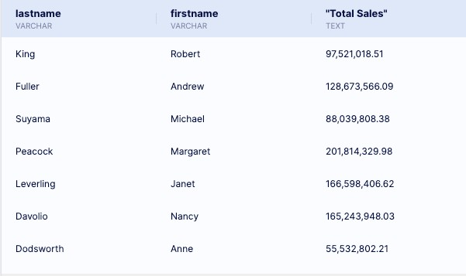
SQL Joins - Cartesian Product
At first glance, the answer set might look reasonable, but it is very wrong !!

Slide 141
SQL Joins - Cartesian Product
SELECT LastName, Firstname,
to_char(sum(unitprice * quantity),'999,999,999.99') as "Total Sales" from "alanparadise/nw"."employees" E,
"alanparadise/nw"."orders" O, "alanparadise/nw"."orderdetails" D
Three tables; TWO
JOIN conditions
where E.employeeid and O.orderidid
= O.employeeid
= D.orderid
GROUP BY LastName, FirstName

Slide 142
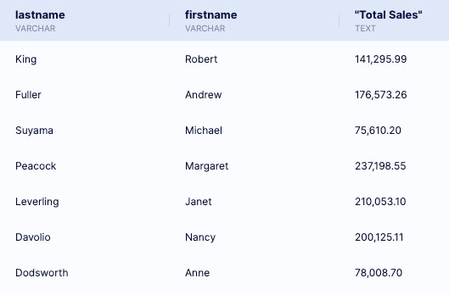
SQL Joins - Cartesian Product
A more reasonable answer !!

Slide 143
SQL Outer Joins
Inner Join:
Returns all the rows where the keys match
Left Outer Join:
Returns all the rows where the keys match PLUS all the rows from the LEFT table
Right Outer Join:
Returns all the rows where the keys match PLUS all the rows from the RIGHT table

Slide 144




SQL Outer Joins
A B
Inner Join
A B
Right Outer Join
A B
Left Outer Join

Slide 145
SQL Outer Joins
Left Outer Join
SELECT LastName, Firstname, count(OrderID) as "Order Total"
FROM "alanparadise/nw"."employees" E "alanparadise/nw"."orders" O
LEFT OUTER JOIN
on E.employeeid = O.employeeid
GROUP BY LastName, FirstName Order By 3 desc;
Returns matching rows from the orders table, and ALL the rows from the employees table
Will show any employees with no orders.

Slide 146
SQL Outer Joins
Right Outer Join
SELECT LastName, Firstname, count(OrderID) as "Order Total"
FROM "alanparadise/nw"."employees" E "alanparadise/nw"."orders" O
RIGHT OUTER JOIN
on E.employeeid = O.employeeid
GROUP BY LastName, FirstName Order By 3 desc;
Returns matching rows from the employees table, and ALL the rows from the orders table
Will show any orders with no matching employee.

Slide 147
SQL Outer Joins
Data Analysis using Outer Joins
Are there orders in the nwOrders table that have an invalid reference to a Northwinds customer?

Slide 148
SQL Outer Joins
Analyzing Orders and Customers.
SELECT COUNT(customerid)FROM "alanparadise/nw"."customers"
There are 87 customers in the customers table
SELECT COUNT(distinct customerid)FROM "alanparadise/nw"."orders"
There are 88 distinct customers in the orders table
Is my data corrupt? What’s going on here…?

Slide 149
SQL Outer Joins
Find any orders in the orders table whose customerID is NOT in the customers table
Method One: use a subquery
SELECT DISTINCT customerid
FROM "alanparadise/nw"."orders" WHERE customerid NOT IN (
SELECT customerID FROM "alanparadise/nw"."customers");
This shows us FOUR customers who have orders in the Orders table that have no matching row in the Customers table
BONAP BSBEV LACOR LAMAI

Slide 150
SQL Outer Joins
Find any orders in the orders table whose customerID is NOT in the customers table
Method Two: use an Outer Join
SELECT DISTINCT O.customerid
FROM "alanparadise/nw"."orders" O LEFT OUTER JOIN "alanparadise/nw"."customers" C on C.customerid = O.customerid
WHERE C.customerid is NULL
This shows us FOUR customers who have orders in the Orders table that have no matching row in the Customers table
BONAP BSBEV LACOR LAMAI

Slide 151
SQL Outer Joins
So what is the impact of this?
(That is, what is the impact of having several orders with bad customerID’s?)

Slide 152
SQL Outer Joins
Inner Join:
SELECT C.customerid, CompanyName, COUNT(orderid) FROM "alanparadise/nw"."orders" O
JOIN "alanparadise/nw"."customers" C ON O.customerID = C.customerID GROUP BY C.customerid, CompanyName
SELECT COUNT(orderid)
FROM "alanparadise/nw"."orders" O
JOIN "alanparadise/nw"."customers" C ON O.customerid = C.customerid
This shows us a total of 763 orders

Slide 153
SQL Outer Joins
Outer Join:
SELECT C.customerid, CompanyName, COUNT(orderid) FROM "alanparadise/nw"."orders" O
LEFT OUTER JOIN "alanparadise/nw"."customers" C
ON O.customerID = C.customerID GROUP BY C.customerid, CompanyName
SELECT COUNT(orderid)
FROM "alanparadise/nw"."orders" O
LEFT OUTER JOIN "alanparadise/nw"."customers" C ON O.customerid = C.customerid
This shows us a grand total of 808 orders

Slide 154
SQL Outer Joins
So what is the impact of several orders having bad or missing customerID’s?
This shows a discrepancy in the number of orders
763 orders versus 808 orders

